Slide 1
NAV
Water and Waste Water Adoption

Slide 2
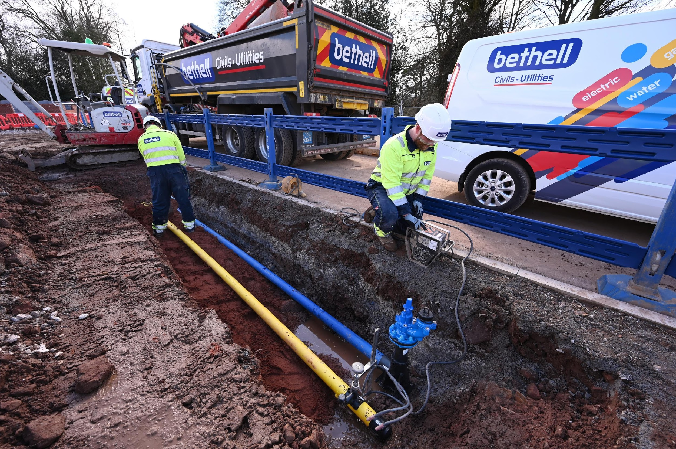
NAV
Water and Waste Water Adoption

Slide 3
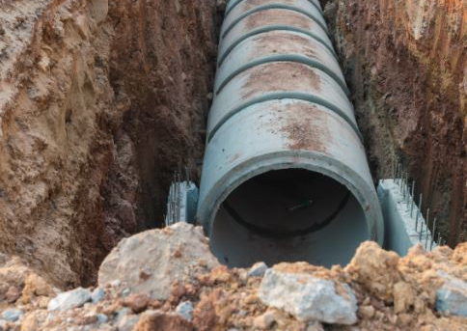
What is a NAV?
New Appointments And Variations (NAV) are independent water companies who provide a “clean” water and/ or “wastewater” service to customers in a sector which was previously managed by the incumbent monopoly provider.
The NAV is the local independent water company for a development. It will own the water network and will be responsible for the supply of potable water and the removal of wastewater of the residents on the site.

Slide 4
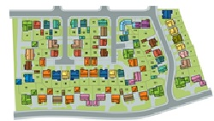
Background
Competition has been established for many years, similar to the model of Electricity and Gas.
NAVs have been in existence since 2007 and started in the Anglian water area.
The implementation of a competitive framework by OFWAT in 2018 started to address issues with the process.
Housebuilders now have the “choice” for asset ownership and network installation.
To-date 100’s of NAVs granted and the NAVs are operating in most areas of the UK.

Slide 5
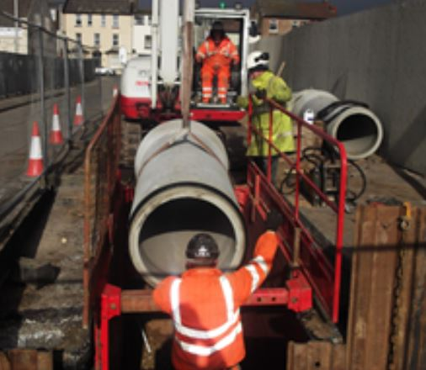
The Role of the NAV
A NAV has the same duties and responsibilities as the incumbent water company and are also regulated.
The NAV will “own” the water network and will be responsible for the supply of potable water & the removal of wastewater for the residents on your site.
Adoption of the potable water networks.
Adoption of foul and surface water infrastructure (constructed by the housebuilder) to agreed standards.
Long-term ownership and operation of the water and wastewater network.
“All” customer supply services (including metering and billing) through the independent water company. residents on your site.

Slide 6
NAV Process Timeline
Initial checks . Application sent to OFWAT for checks of the application.
Up to 5 days
Assessment and recommendation to the decision maker to consult
OFWAT carry out detailed assessment of the application
Up to 45 days
Public consultation on the proposal
28 days
Final decision.
OFWAT considers consultation responses and makes decision
7 Days
NAV is granted.
Total 85 days
Note
NAVs are working behind the scenes to reduce the days to a more favourable
55 days

Slide 7
Benefits of working
with a NAV
Substantial Commercial benefits over and above that of the incumbent water company
More flexible approach ( possible use of plastic pipes and other modern solutions)
No Bonds required
No inspections fees
No fees for the adoption process
No fees for Pump station approval
Will adopt “SuDS” (including head walls/ fences and surrounding landscape
Technical approval in 15 days
Phased adoptions
Will assess a development from 40 plots upwards (charges “may” apply with some NAV’s)
Reduced maintenance periods on larger sites (phased vesting subject to meeting standards)

Slide 8
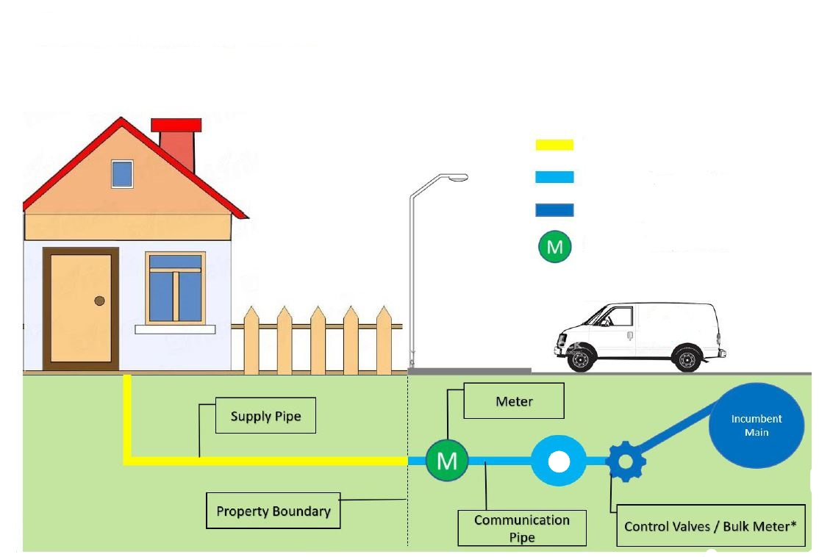
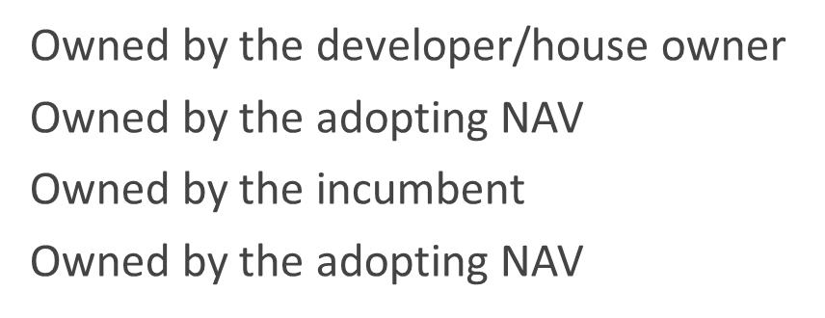
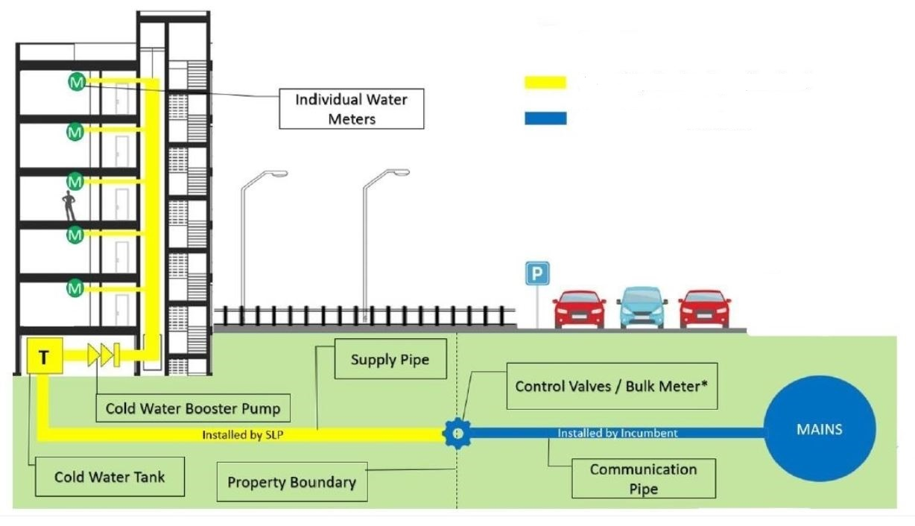
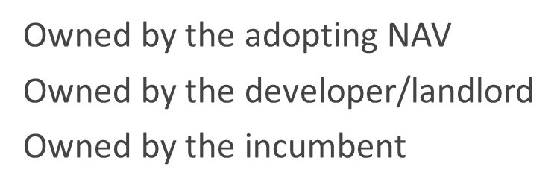
Bethell Utility Services
We will assist with adoption of the clean & wastewater networks on new housing developments & apartments, offering a flexible, phased approach to adoption as well as managing the entire process.

Slide 9
FAQ’s
Q – What is the catch?
A - In summary there is no catch and by introducing more competition within the industry along with the change in legislation, NAV’s are now able to offer a bespoke, alternative commercial and adoption proposal to that of incumbent monopoly water companies.
Q – What about my temporary water connection?
A-For a TBS to be installed on “new” mains, the NAV must have their NAV licence already granted, therefore timing and early engagement is key. Alternatively, the TBS can be requested from the incumbent water company.
Q - Can I change my mind to go down the NAV route during the “normal” process?
A-Yes, however the developer must cancel the S104 adoption application with the incumbent water company before any construction has started on site which may incur charges/ cancellation fees.

Slide 10
FAQ’s
Q - What if the NAV is not granted a license to serve the development?
A – The NAV must detail a contingency arrangement in the application. This usually defaults to the incumbent water company which ensures that no consumer will be left without a water connection.
Q- Does my site have to be an “unserved” site?
No, a development can be a served development however, there are additional steps that the NAV has to take during the licence application process to address these situations, which involves consultation with the existing customers.
Q- Who signs the 104 agreement?
A-The S104 sewer adoption agreement is signed by the developer in the same way as if it were the incumbent water company adopting.

