Slide 1
Bethell Utility Services Breakfast Forum

Slide 2
Agenda
Format for the morning:
08:00hrs - Paul Connolly (BUSL MD)
Welcome
08:05hrs - Vicki Spiers (ESP Utilities Group)
“No Gas” after 2025 + Q&A
08:30hrs - Break
08:50hrs - Martin Burke (Senior HSQE Manager)
Bethell HSQE Initiatives 2022
09:20hrs - Q&A
09:30hrs - Close

Slide 3
Q&As - Twitter

Slide 4
Paul Connolly – BUSL MD

Slide 5
Future Homes Standard Vicki Spiers
ESP

Slide 6
Future Homes Standard - Context
Net Zero by 2050
enshrined into
UK law in June 2019
Reduce carbon emissions by 78% by 2035.
UK electricity production net-zero by 2035.
All new cars, vans and boiler replacements low-carbon by 2050.
Climate Change Committee
6th Carbon Budget 2033-2037
Recommendations
Electricity demand to double by 2035 and triple by 2050.
Hydrogen production to scale to current electricity production levels.
Reduce heat consumption by 20% by 2030.
National programme of insulation to prevent energy loss.
Plant 460k hectares of woodland by 2035.
COP26 Conference
Flagship Climate Change event
hosted in Glasgow, November 2021

Slide 7
Future Homes Standard - Timeline
Phase 1
Introduce the interim uplift
Dec 2021
Introduce the interim uplift.
June 2022
Regulations come into effect.
Phase 2
Technical work & engagement
Autumn 2021 – Summer 2022
Research technical specification.
Summer 2022 – End of 2022
Develop guidance & embed understanding.
Phase 3
Consultation & policy development
Spring 2023
Technical consultation on proposed specification – including transition arrangements.
Phase 4
Full FHS implementation
2024
Laid before Parliament.
2025
Comes into effect.

Slide 8
Policy challenges
The government is…
Committed to building 300,000 new homes every year by 2025 & keeping energy costs low for consumers.
Targeted to install low carbon heating technology in all new homes from 2025 and 600,000 heat pump installations annually by 2028.
However…
These ambitions now further challenged by multiple supplier failures in the market and increasing cost of living concerns.

Slide 9
Policy challenges
Hard stop in 2025 is creating uncertainty for builders and delaying house building.
Heat pump manufacturing supply chain – only 10k out of 33k needed in the UK built.
Skilled installation workforce not in place – only 1,200 installers out of 10,000 needed to meet government target of 600,000 installs by 2025.
Key challenges
No recognised accredited training scheme in place for heat pump installers.
Heat pump costs significantly higher than gas boilers, impact on new build costs.
Consumer awareness of alternative heating technologies is low.

Slide 10
Ernst & Young research
The INA commissioned independent research from Ernst & Young on the impact of the Future Homes Standard, published in June 2021.
Government should undertake an impact assessment for the Future Home Standard.
Implement the standard so that its co-ordinated with data from ongoing Hydrogen trials.
Provide early clarity on transition arrangements by bringing forward 2023 consultation.
Provide support to the supply chain for heat pump manufacturing.
Key recommendations:
Prevent delays in housebuilding by considering phased introduction of 2025 standard.
Develop an accredited training scheme for heat pump installers.

Slide 11
Other challenges
Ambitions to maintain low energy costs
Hit by soaring global gas costs.
High profile supplier failures in 2021
Created an estimated £800m of costs.
Short-lived government funding and support schemes
Dented customer confidence, reduced future success
Challenging timetable to secure legislation
Potential impact of 2024 General Election
No programme to raise consumer awareness
Less than 1 in 5 people recognise this as contributing factor to climate change
?

Slide 12
Stakeholders
Department for Business Energy & Industrial Strategy (BEIS)
Including providing evidence to the Select Committee
Parliamentarians
Junior Energy Minister
Chair of Environmental Audit Committee
Chair of APPG on Hydrogen
Vice Chair of APPG for SME House Builders
Chair of APPG on Housing & Social Mobility
Members of APPGs on Housing & Infrastructure
House Builders
Small & Large
National & Local
Scottish Government
Ban on gas heating introduced from 2024 in Scotland, but with buildings already “consented” able to build out over time.
Department for Levelling Up Housing & Communities
Ofgem
House Builders Federation
Future Homes Delivery Hub
Energy Utilities Alliance

Slide 13
Assessment of Effectiveness of Policy
Public Accounts Committee Achieving Net Zero report
published 2nd March 2022
Found the government has:
Failed to provide answers on how it will fund transition to net zero.
Is relying heavily on technological innovations and consumer behaviour changes to drive down costs of green options.
Is unclear on how it will support consumers to purchase greener products.
Pursued stop-start strategies that have undermined stakeholder confidence.
The Committee on Climate Change report published 9th March 2022
“The UK Government’s Heat and Building Strategy has laid out important high-level decisions on the UK’s approach to reducing emissions from heating buildings. The Strategy sets a new policy direction, focusing on a rapid scale-up of supply chains through a market-based approach. However, plans are not yet comprehensive or complete and significant delivery risks remain. Consultations need to move forward, followed rapidly by final decisions on policy design and effective implementation if the Strategy’s ambitious goals are to be met”
The National Infrastructure Commission annual report published 16th March 2022
Their report identified that:
The Net Zero strategy has major gaps around heating decarbonisation, increasing energy efficiency measures and how the cost of transitioning to low carbon infrastructure will be fairly paid for.
Heat and Buildings strategic targets not currently supported by a delivery plan or clear funding.
Remaining unsolved areas that the government needs to address.

Slide 14
What does this mean?
The government is committed in law to achieving Net Zero by 2050.
We, as home builders, constructers and infrastructure owners, should support this goal to reduce the impact of climate change.
Business needs certainty of “What”, “When” and “How” to deliver, which we are pushing government for in every engagement.
Unfortunately, there is currently no clear roadmap to implement the Future Homes Standard by 2025.

Slide 15
Real world developer experience
Local accelerated decarbonisation targets
Strong interest in hydrogen across the board, want to provide consumer choice
House building sector & social housing provider insights
Hydrogen boilers seen as more ‘consumer-friendly’ technology.
Heat pumps may not be commercially viable for some affordable housing schemes
Concerns about consumer acceptance and cost of heat pumps in social housing.

Slide 16
Optimal approach for developers
Build expertise and supply chains in low carbon alternatives.
Heat pumps & hydrogen ready boilers.
Work with Government to shape the proposed end to new gas connections now.
H
X
Given the uncertainty to timing and nature of ban & barriers to consumer adoption…
Maximise new gas connections until the last possible moment.
Install required networks & technologies for the probable onset of Hydrogen.
???
H
H

Slide 17
Q&A

Slide 18
Refreshment Break

Slide 19
Martin Burke – Senior HSQE Manager

Slide 20
Our values

Slide 21
HSQE statistics
2021 | Jan | Feb | Mar | Apr | May | Jun | Jul | Aug | Sep | Oct | Nov | Dec
Reportable incidents (#) | 0 | 0 | 0 | 0 | 0 | 0 | 0 | 0 | 0 | 0 | 0 | 0
Year to date AFR | 0 | 0 | 0 | 0 | 0 | 0 | 0 | 0 | 0 | 0 | 0 | 0
12 months rolling AFR | 0 | 0 | 0 | 0 | 0 | 0 | 0 | 0 | 0 | 0 | 0 | 0
2021 | Jan | Feb | Mar | Apr | May | Jun | Jul | Aug | Sep | Oct | Nov | Dec
Incidents (#) | 1 | 0 | 0 | 1 | 0 | 0 | 0 | 0 | 0 | 0 | 0 | 0
Year to date AAFR | 2.44 | 1.22 | 0.8 | 1.2 | 0.96 | 0.8 | 0.68 | 0.59 | 0.52 | 0.46 | 0.41 | 0.19
12 months rolling AAFR | 1.50 | 1.52 | 1.13 | 1.32 | 1.32 | 1.32 | 1.32 | 1.32 | 1.17 | 0.97 | 0.39 | 0.19
1,550,287 hours worked since last RIDDOR

Slide 22
HSQE statistics
BREAKDOWN OF PERSONNEL INCIDENTS
Fatality
0
0
1
0
3
187
Riddor
SEVERITY
Lost time
Medical treatment
Near miss
Hazard
Observations

Slide 23
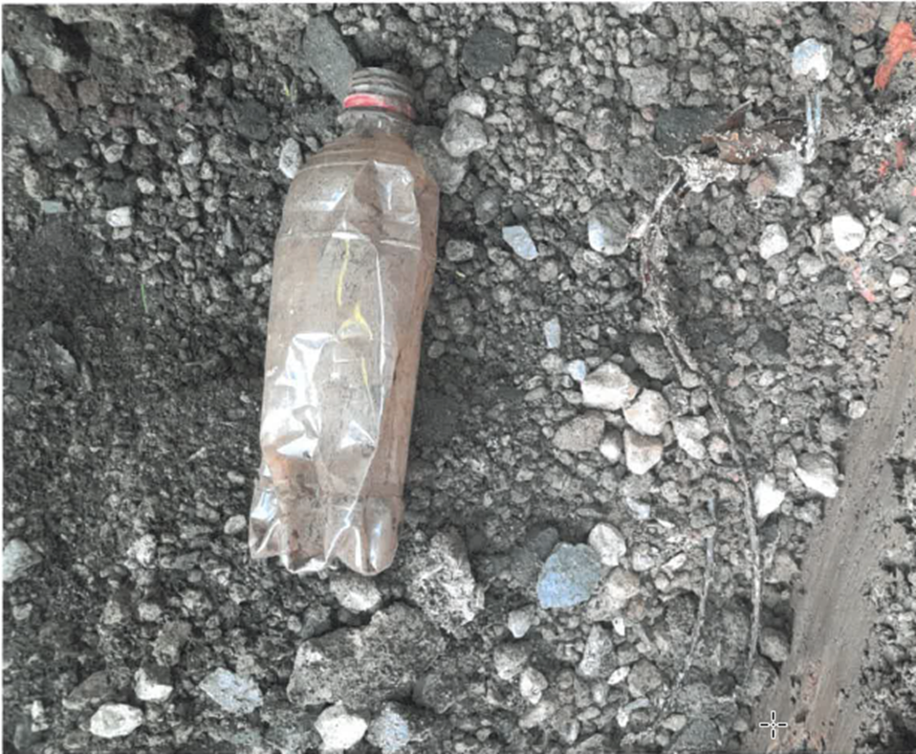
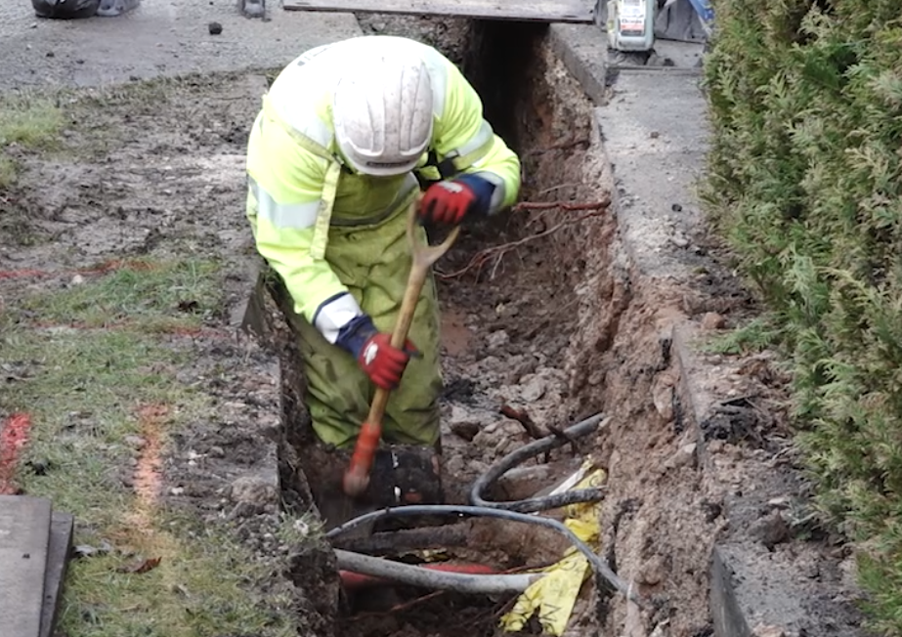
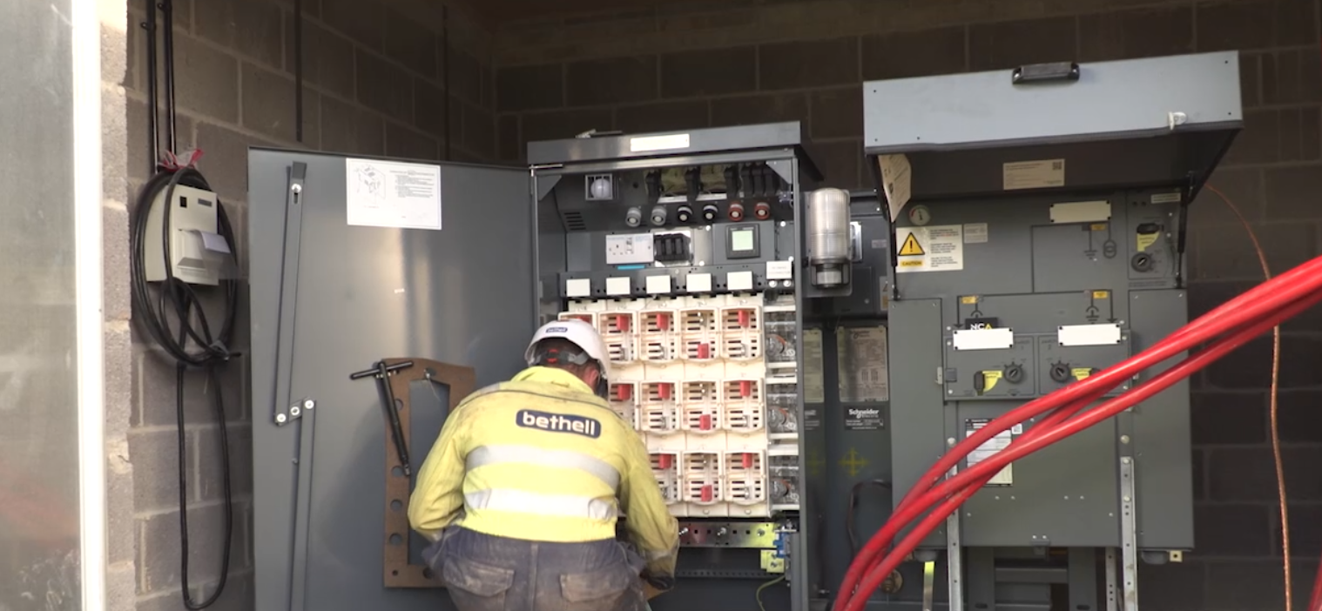
Avoiding underground services

Slide 24
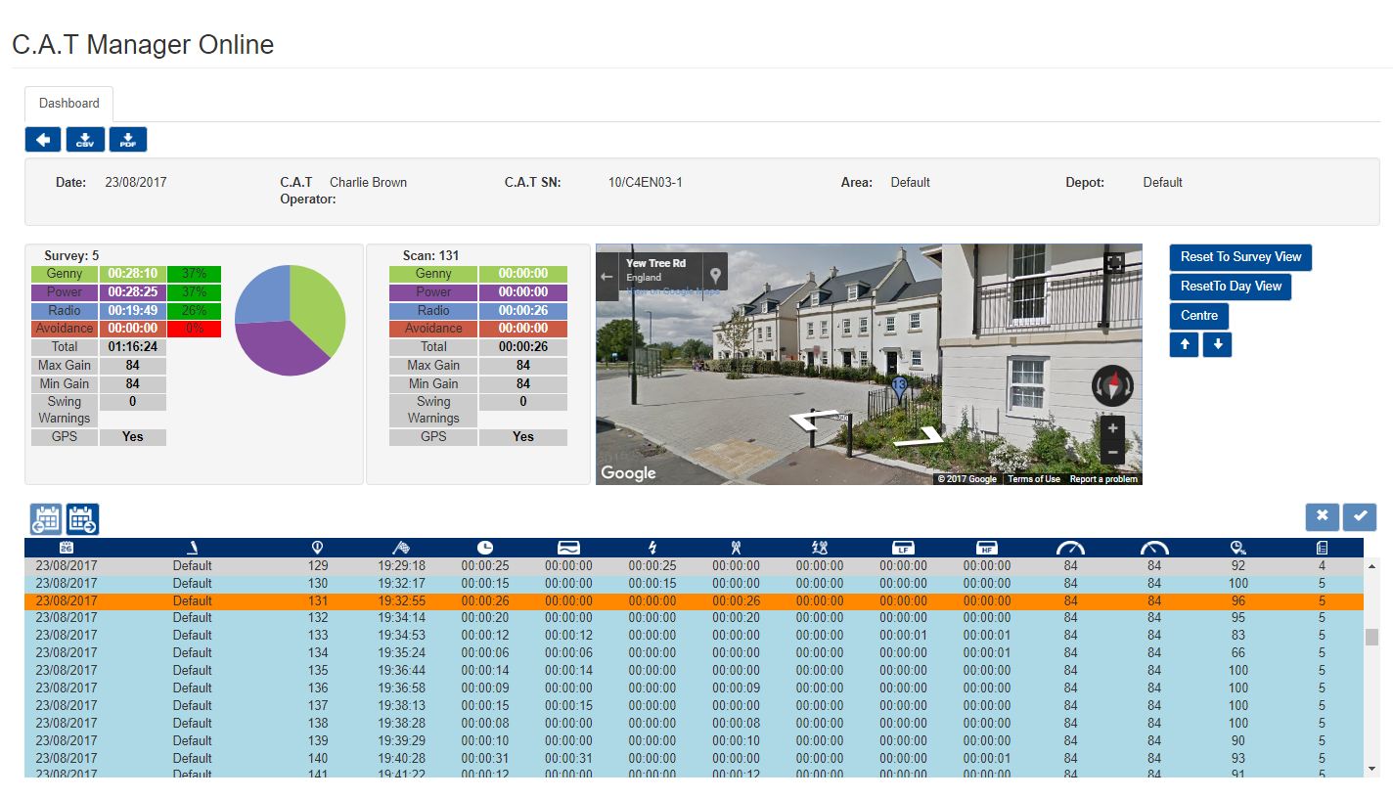
Avoiding underground services

Slide 25
Avoiding underground services

Slide 26
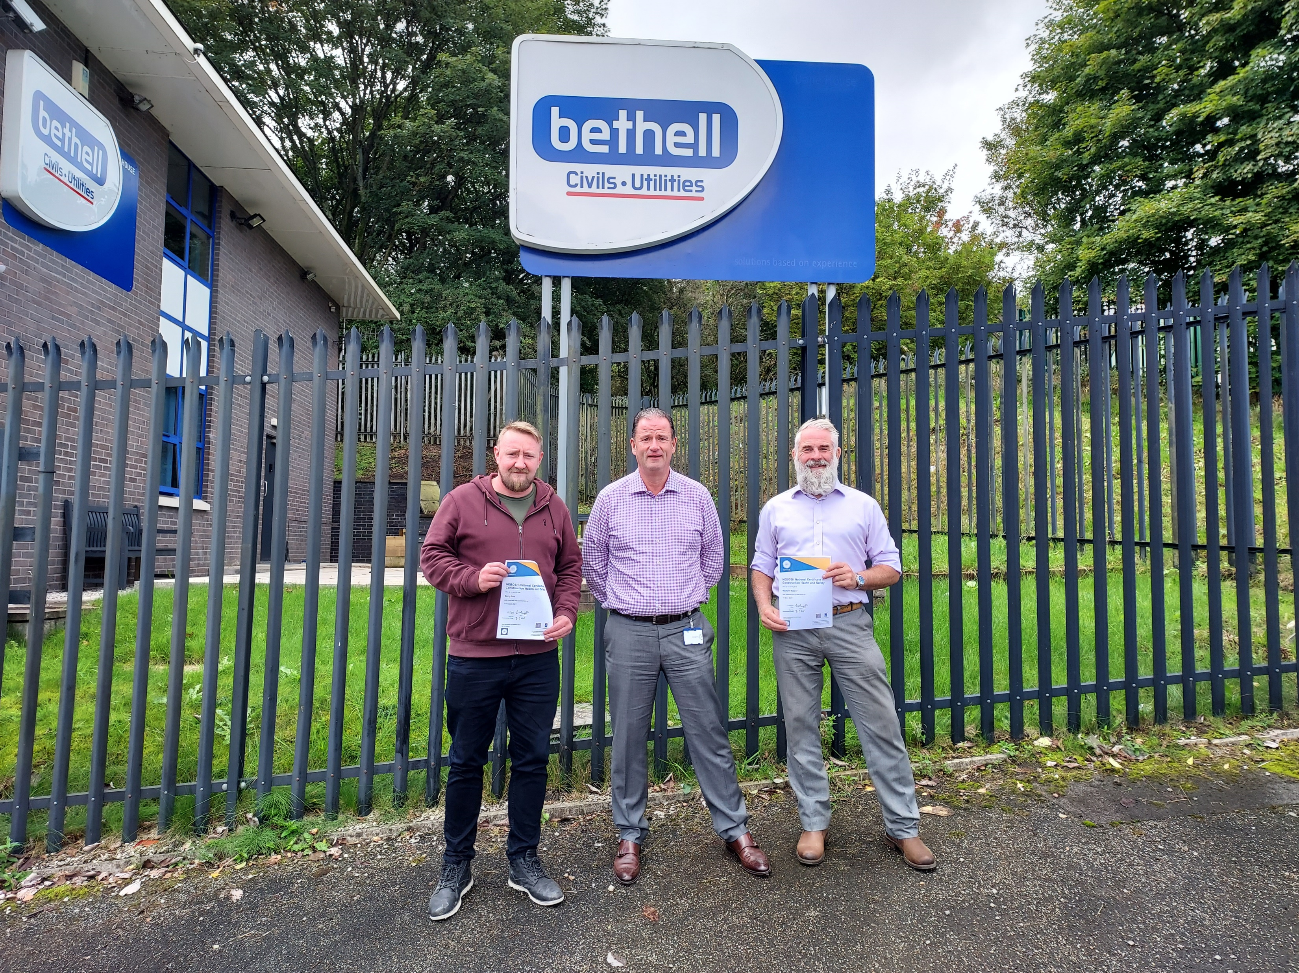
Training

Slide 27
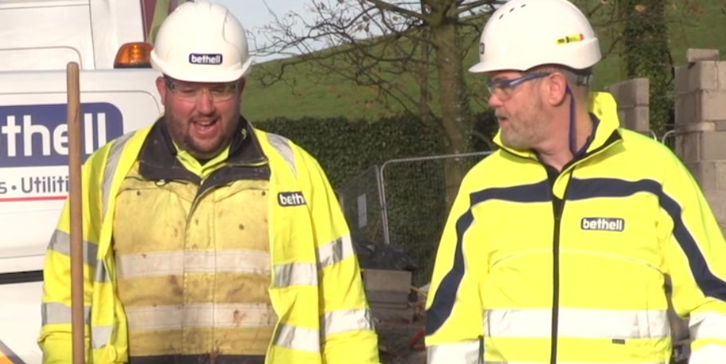
HSQE audits & inspections

Slide 28
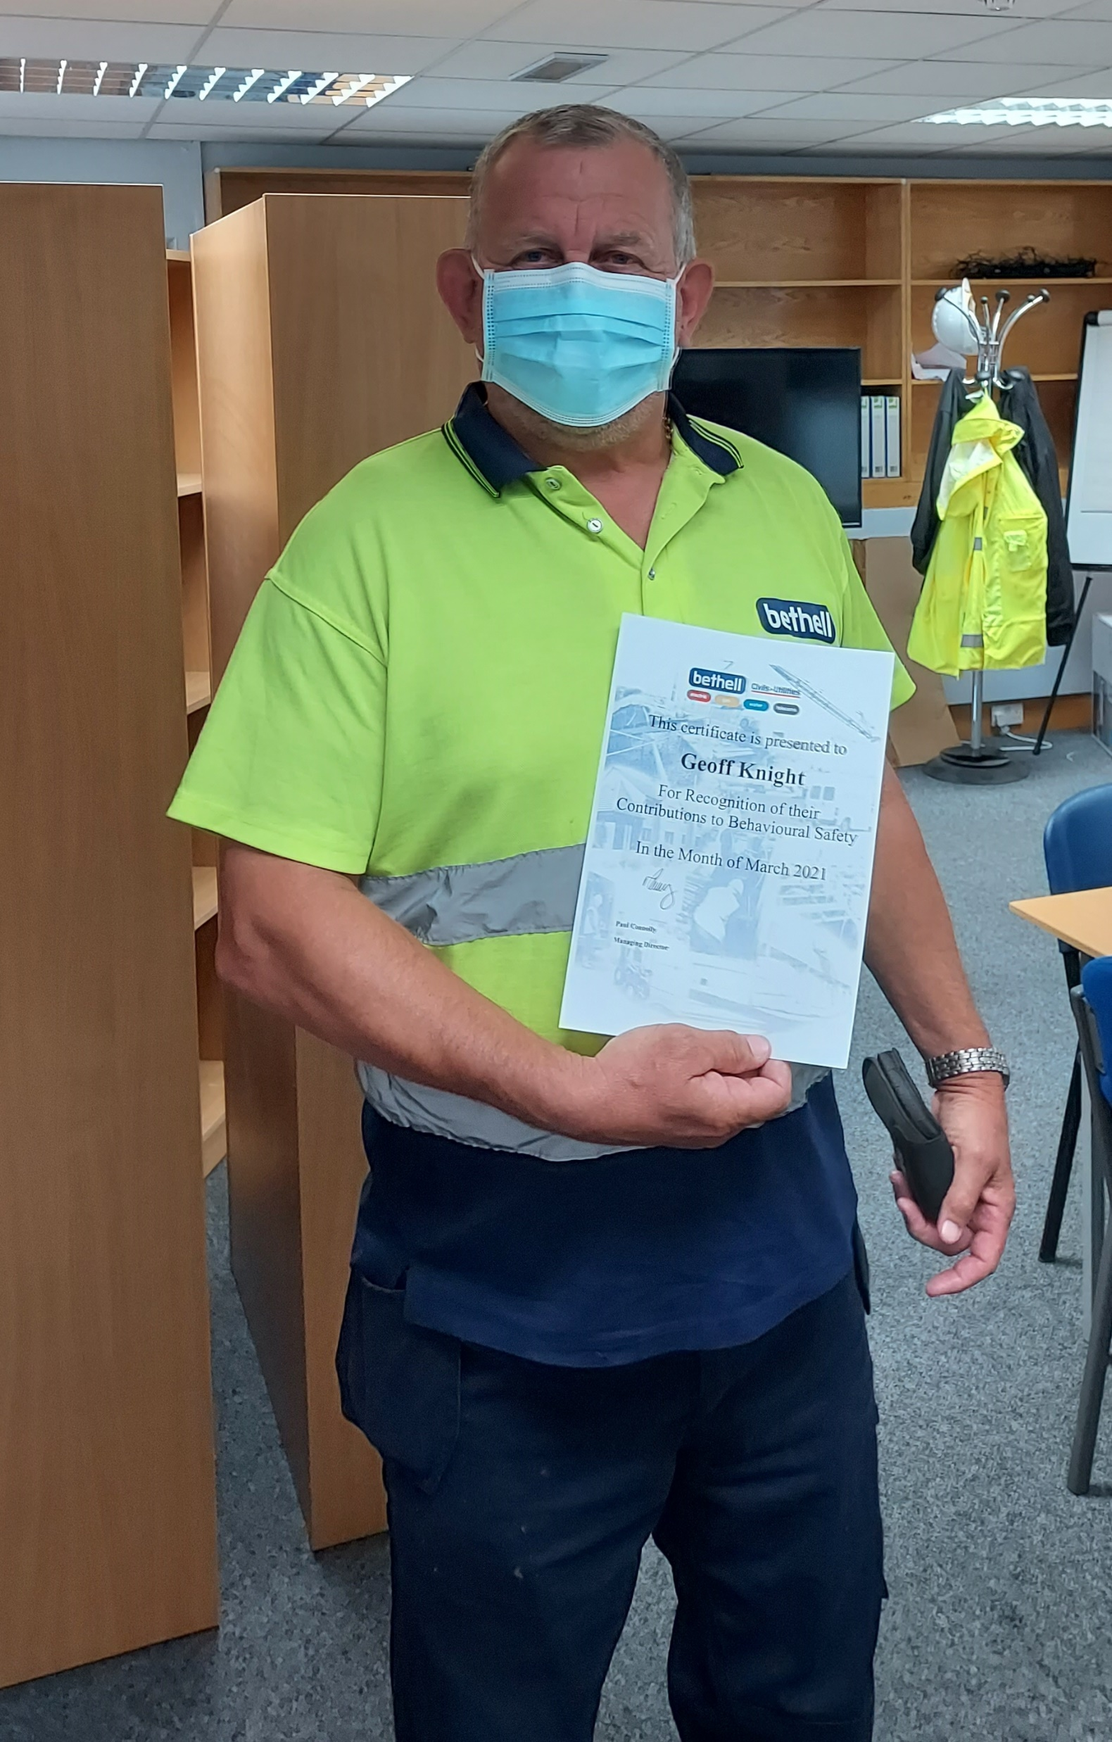
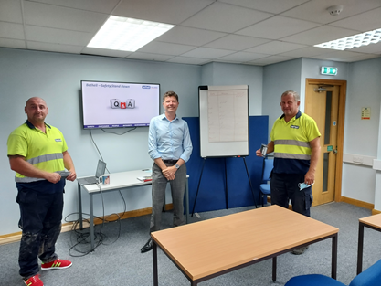
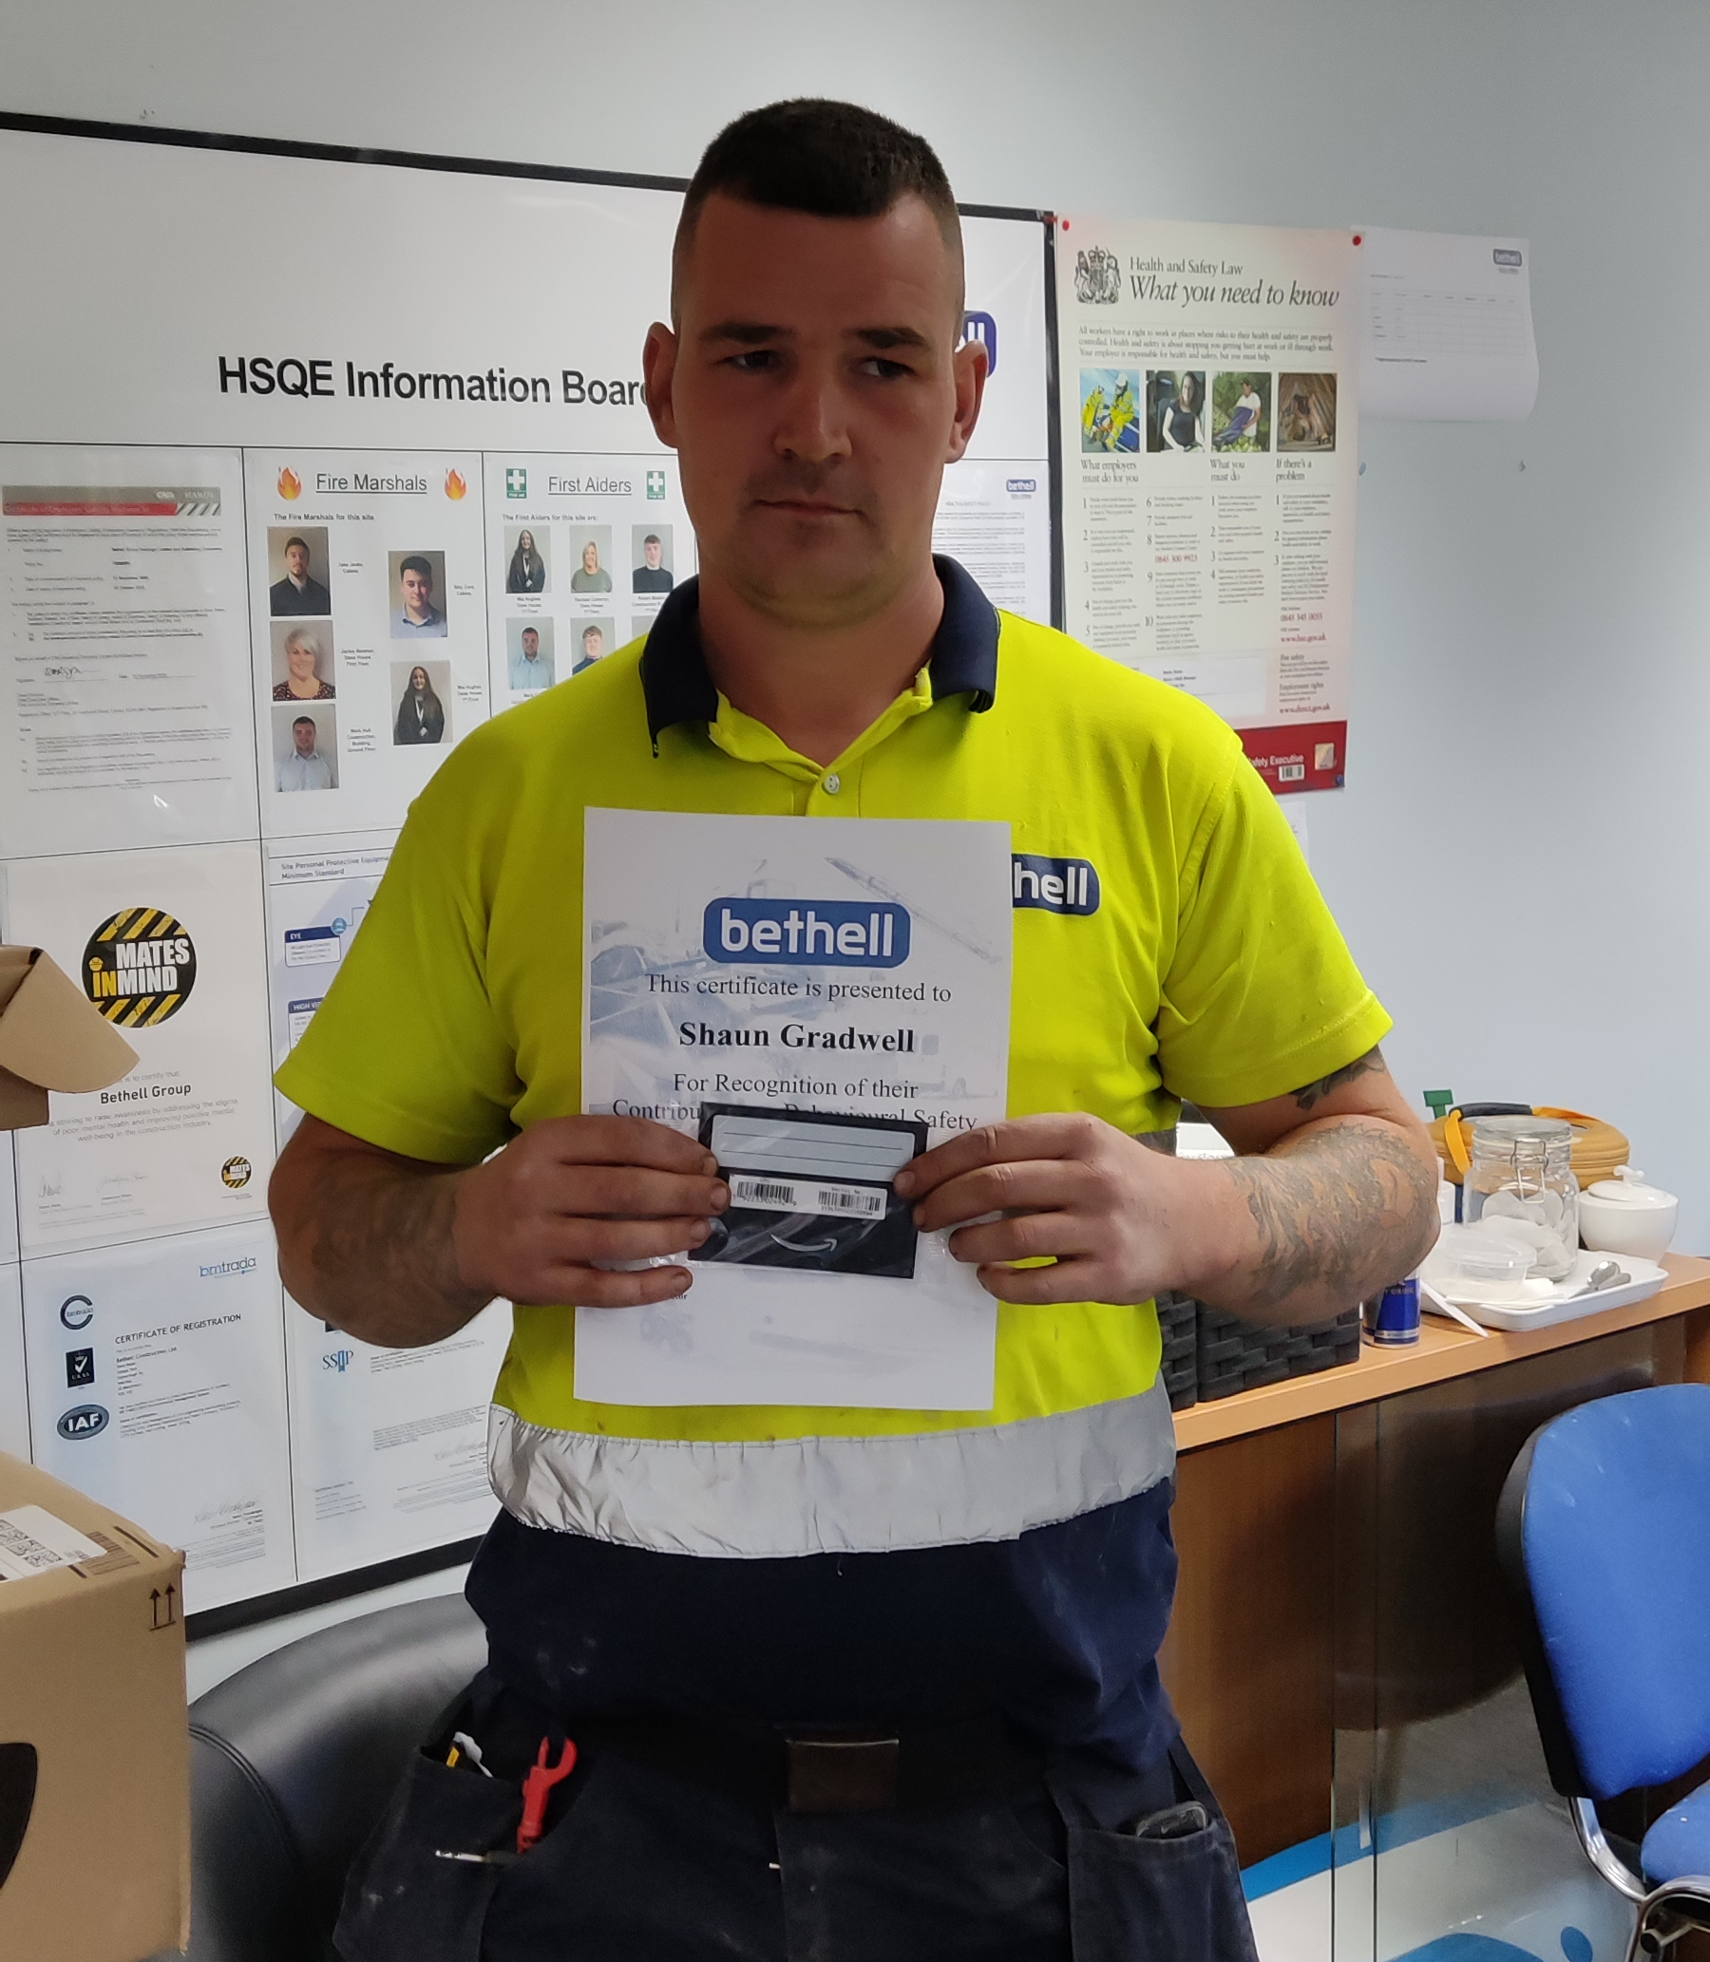
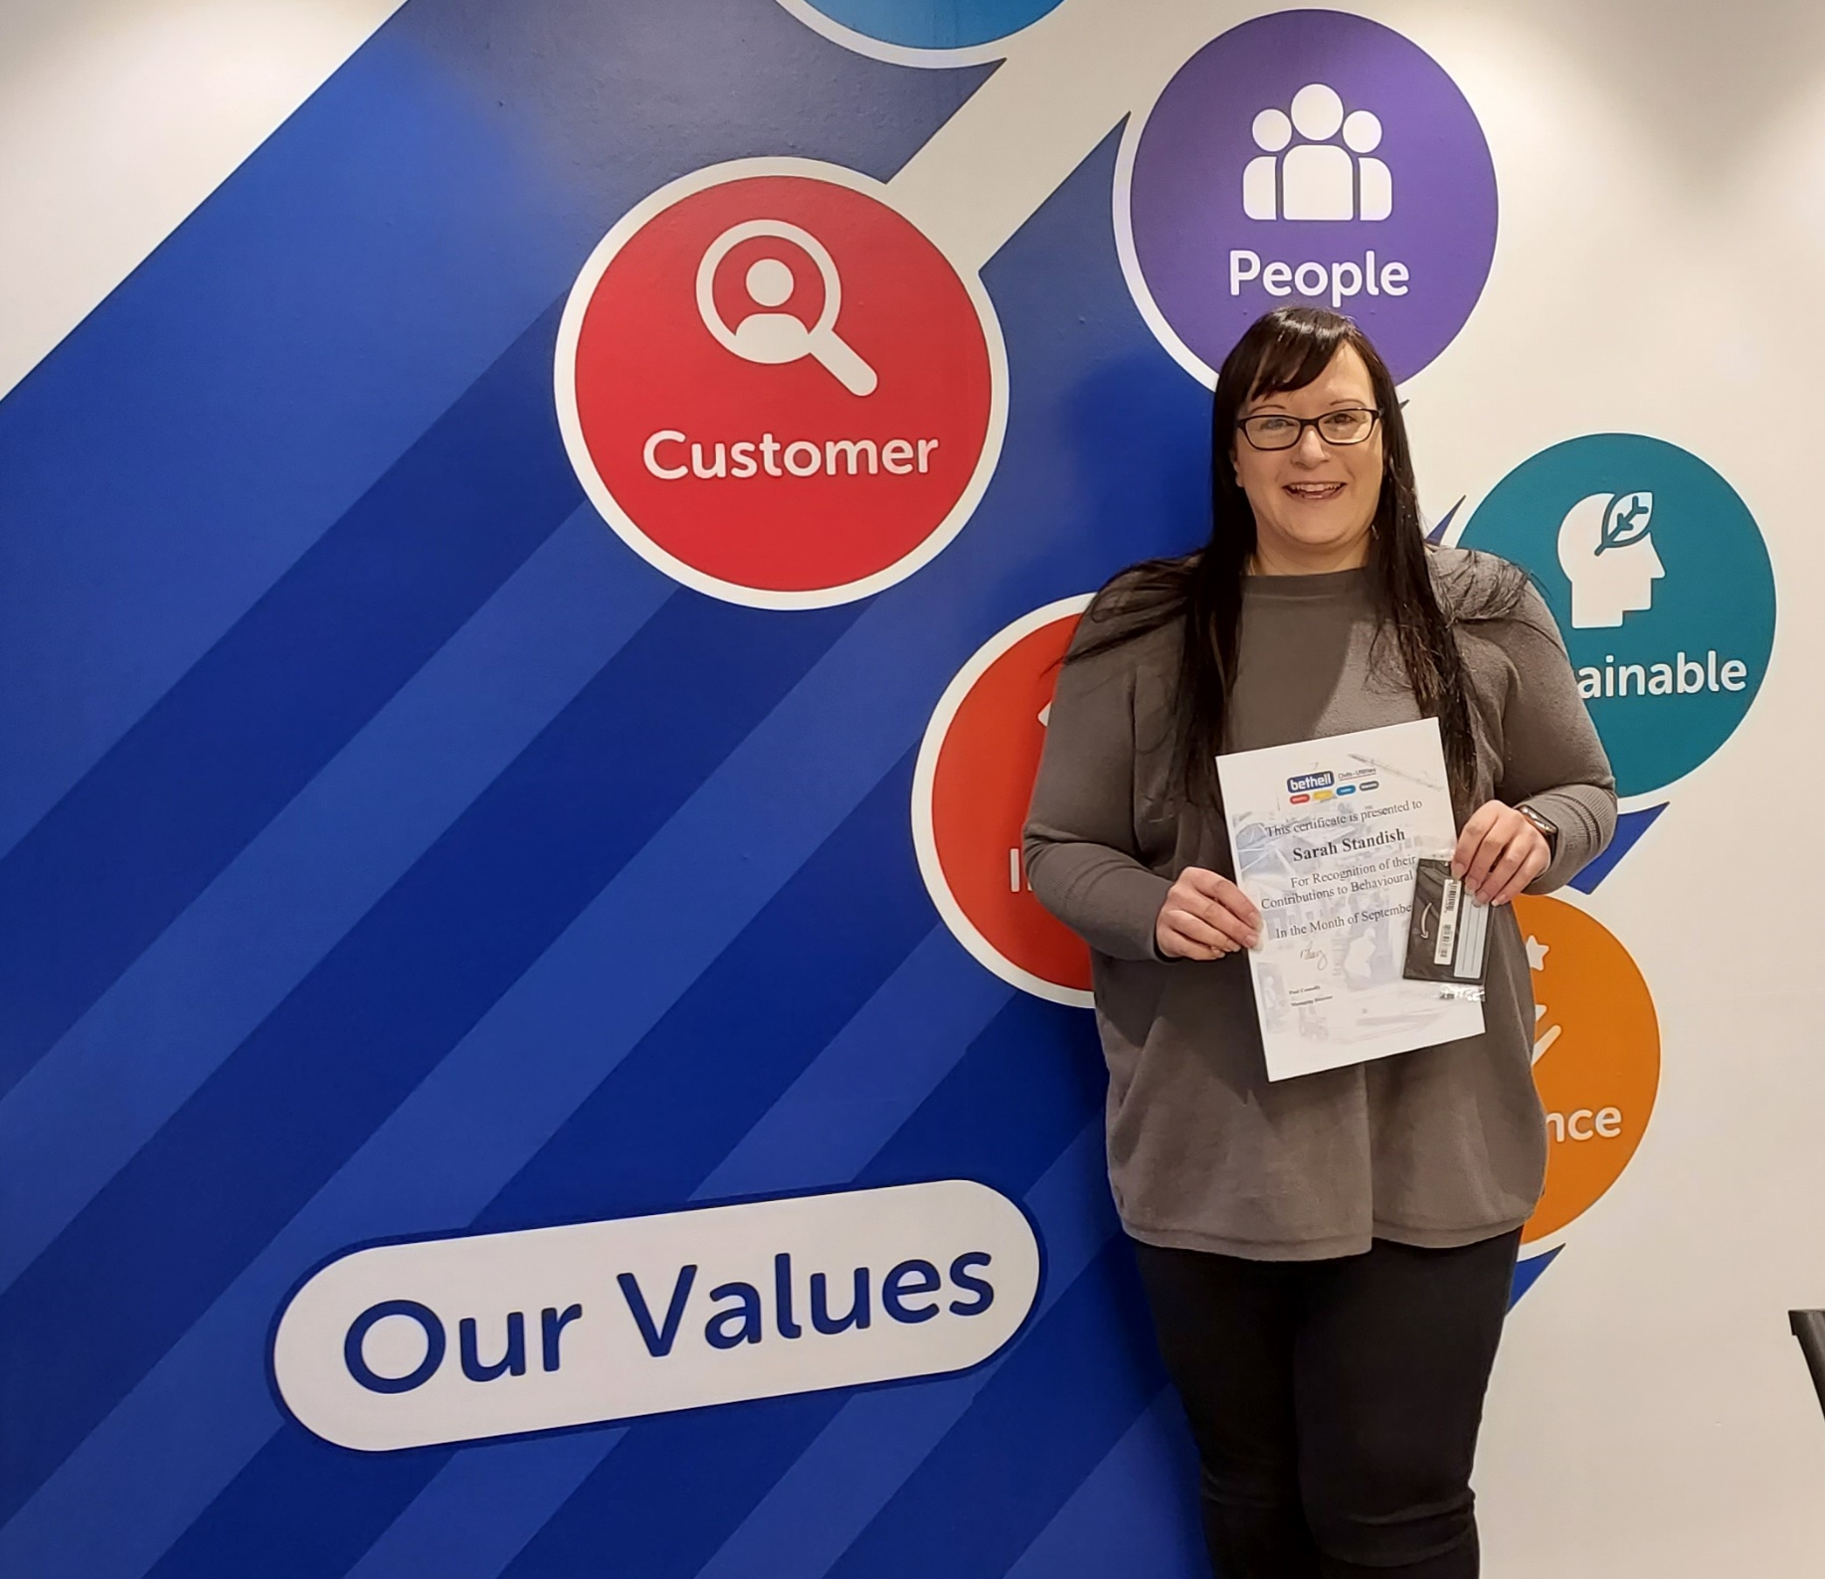
Hazard spotting/safety awards

Slide 29
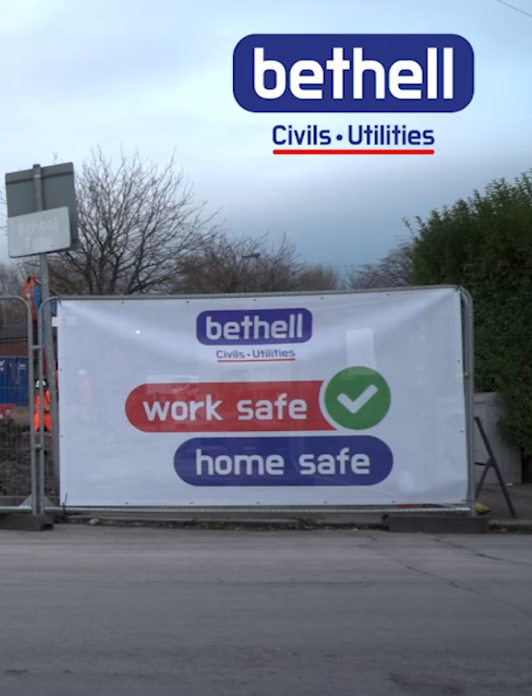
Red & yellow cards

Slide 30
Safety Stand Down Days

Slide 31
Q&A

Slide 32
Close

Slide 33
Thank you for listening!

